Slide 1
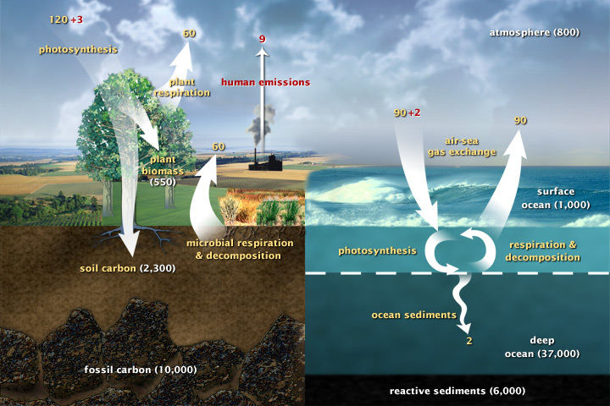
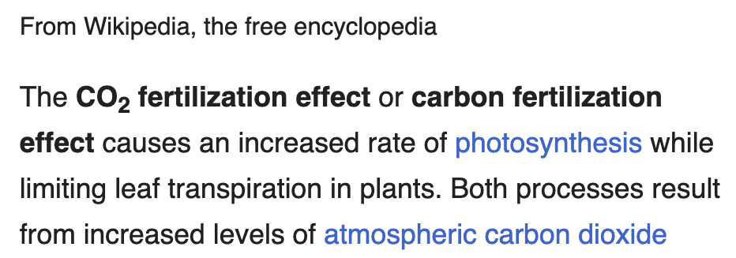
Week 3: We learned about the CO₂ fertilization effect

Slide 2
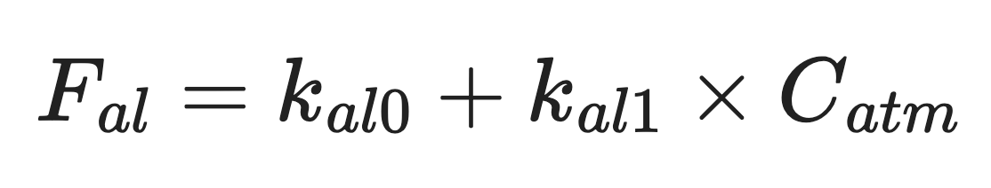
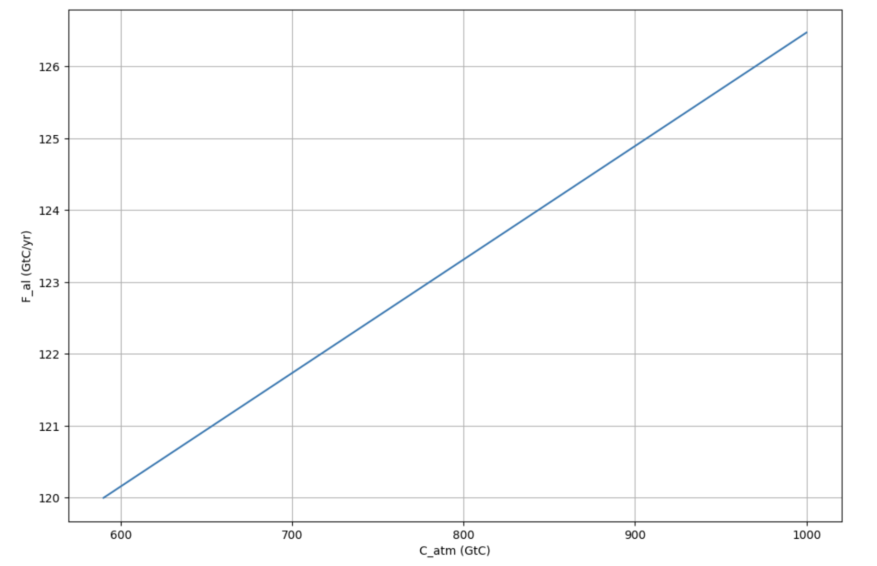


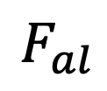

Week 4: We made the CO₂ fertilization effect quantitative
$910 GtC$in 2026
$$F_{al}$$
$800 GtC$in 2003
$590 GtC$ in pre-industrial times
$$C_{atm}$$

Slide 3
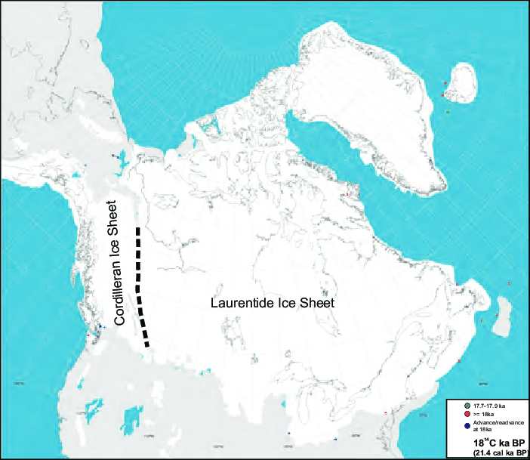
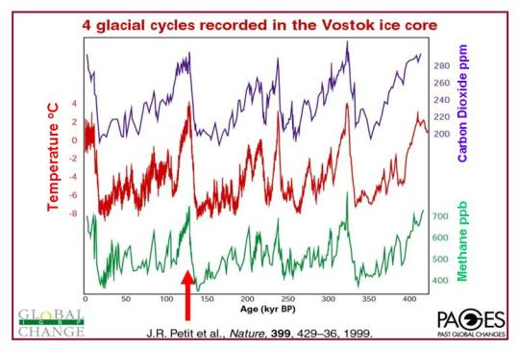
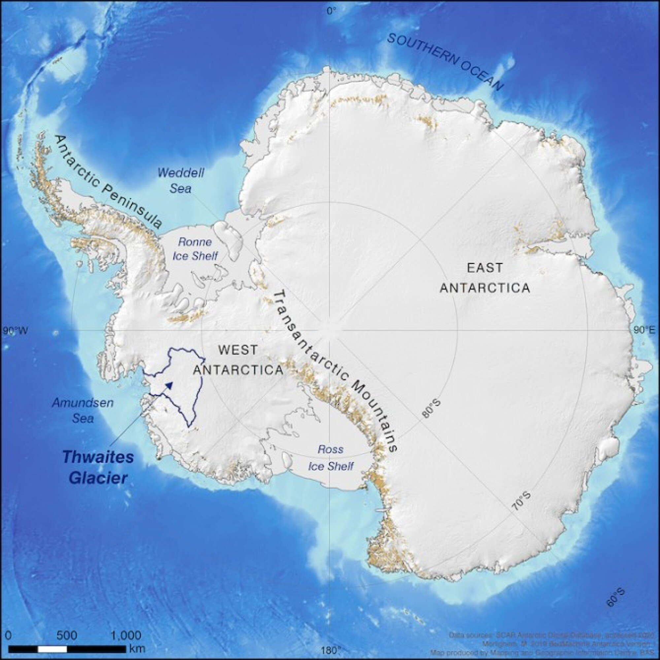
Week 4: We learned about Earth wobbling and the 100,000-year glacial/interglacial pattern
Present <------- 400,000 years ago

Slide 4
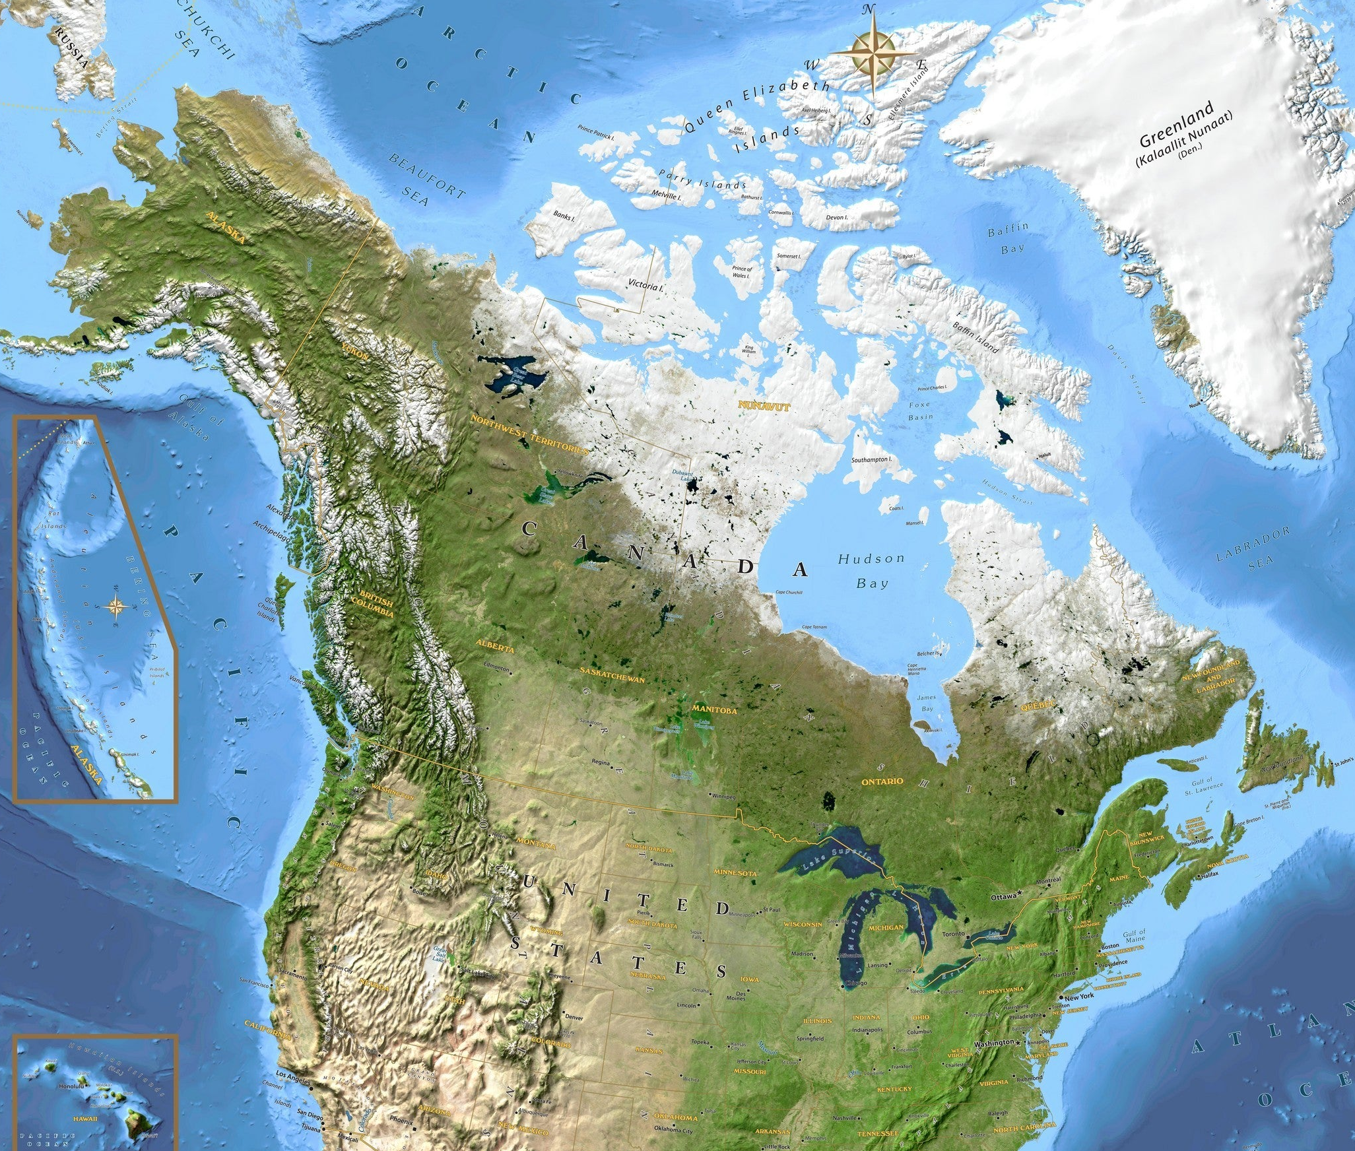
Week 4: We learned about Earth wobbling and the 100,000-year glacial/interglacial pattern
Present <------- 400,000 years ago
N. American (and Asian) ice sheets recede
Eemian
WAIS slips into the ocean during the Eemian (but hasn’t done so in our current warm period)

Slide 5
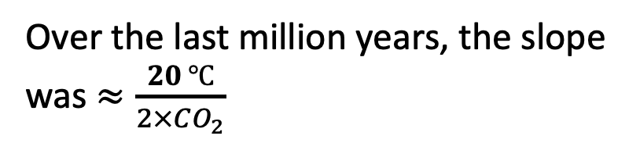
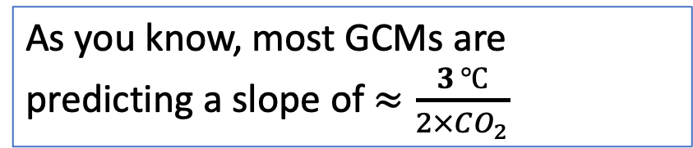
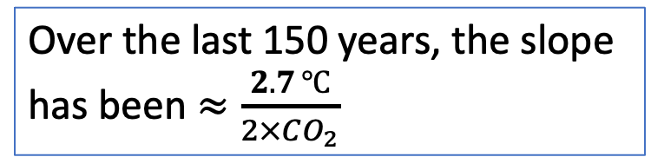
Week 4: We compared GCM-derived ECS to the ECS of the last 150 years, and the Pleistocene
Over the last million years, the slope was $≈\frac{20 ℃}{2×CO_{2}}$
As you know, most GCMs are predicting a slope of $≈\frac{3 ℃}{2×CO_{2}}$
T (relative to 1960)
Over the last 150 years, the slope has been $≈\frac{2.7 ℃}{2×CO_{2}}$
Courtesy Penny Rowe
Courtesy Penny Rowe

Slide 6
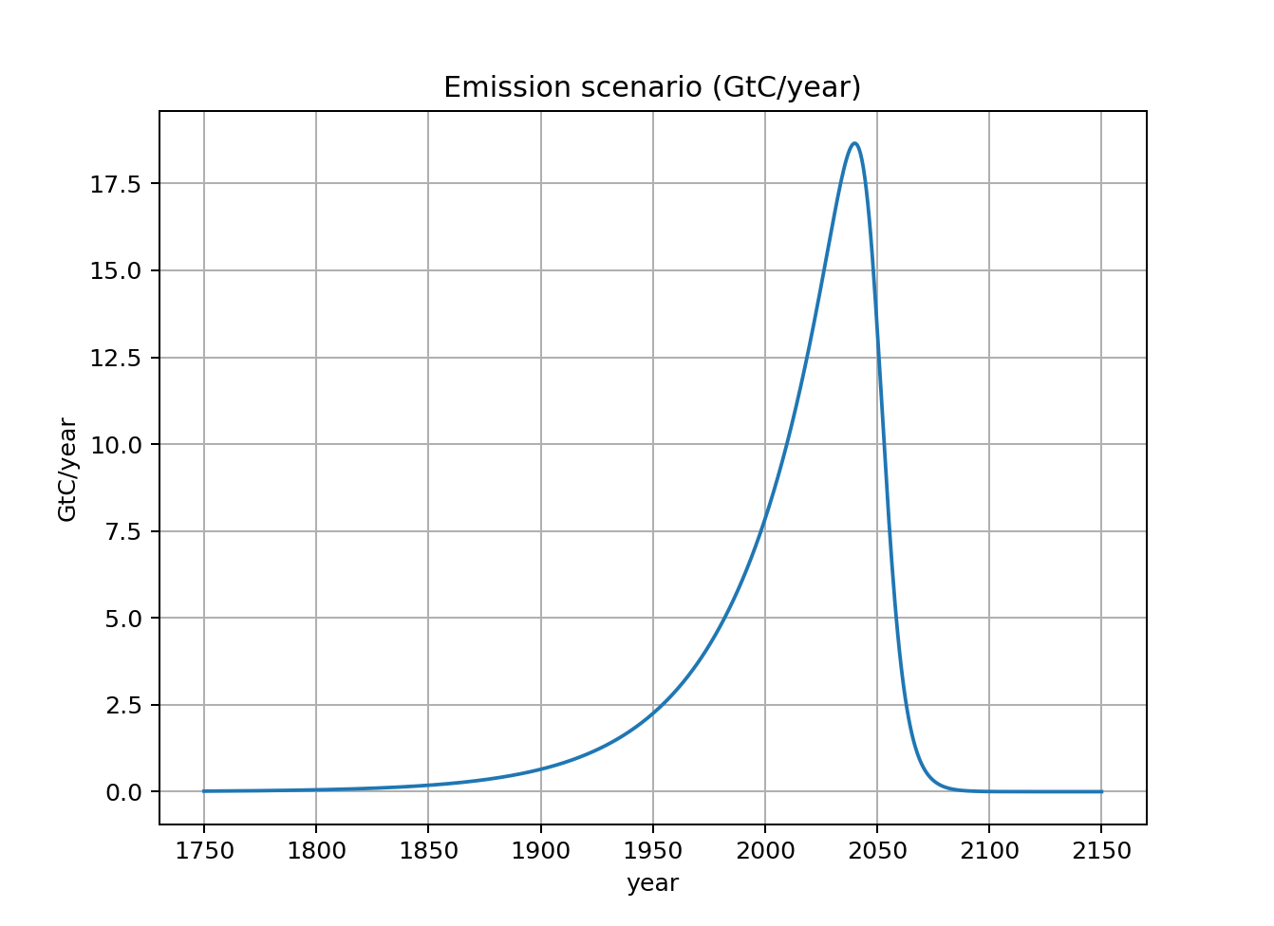
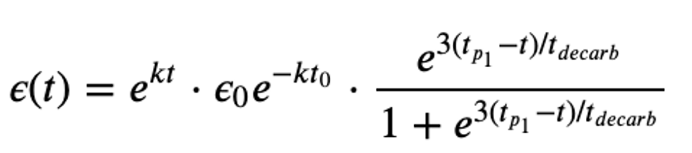
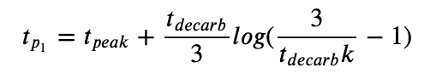
Week 4: We wrote code (ScheduledFlows) that creates an “emission scenario”

Slide 7
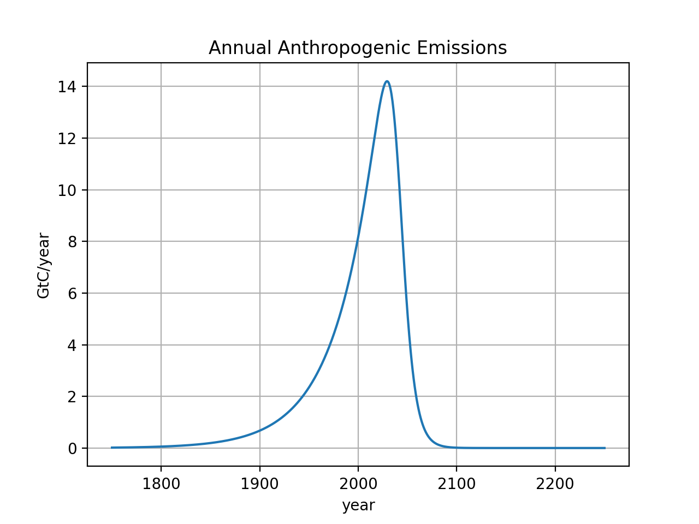
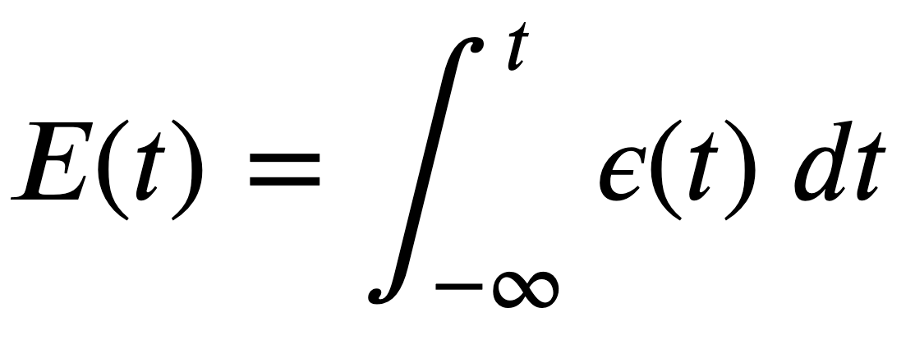
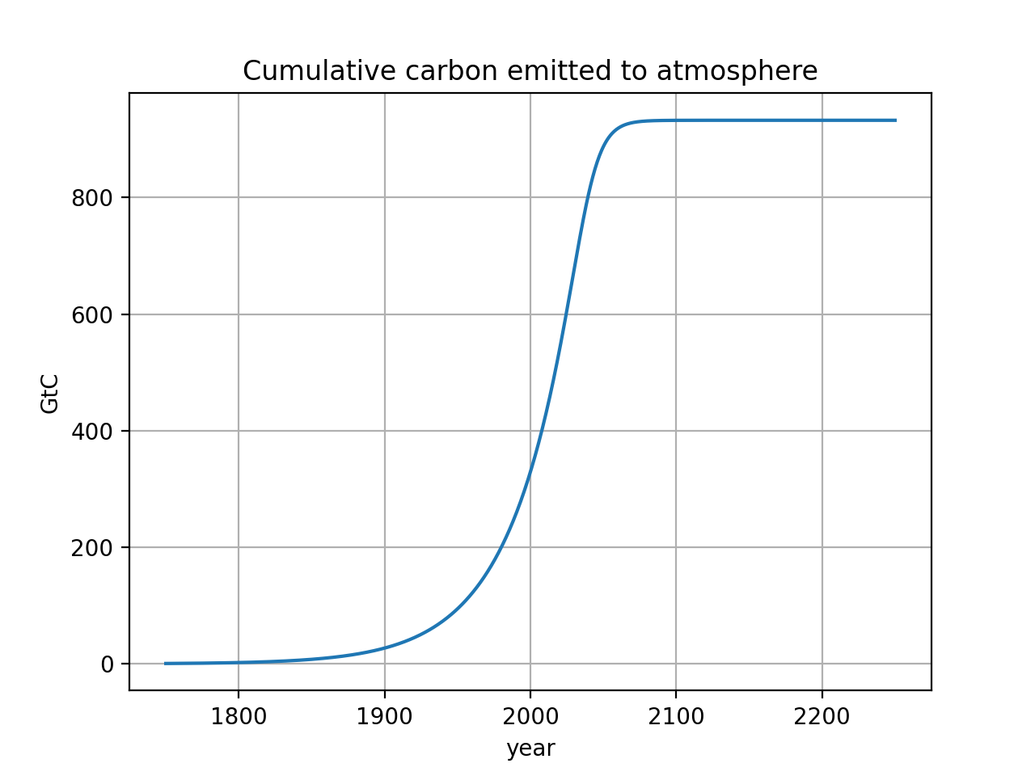
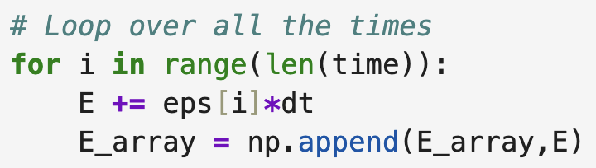
Week 4: We also wrote code that adds up emissions over time (CumulativeAnalysis)
Integral calculus:
$\sim 1000$ GtC burned in this scenario
It’s thought that ~4000 GtC is the total Earth reserve, so ~70-75% would be left in the ground
In Python:

Slide 8
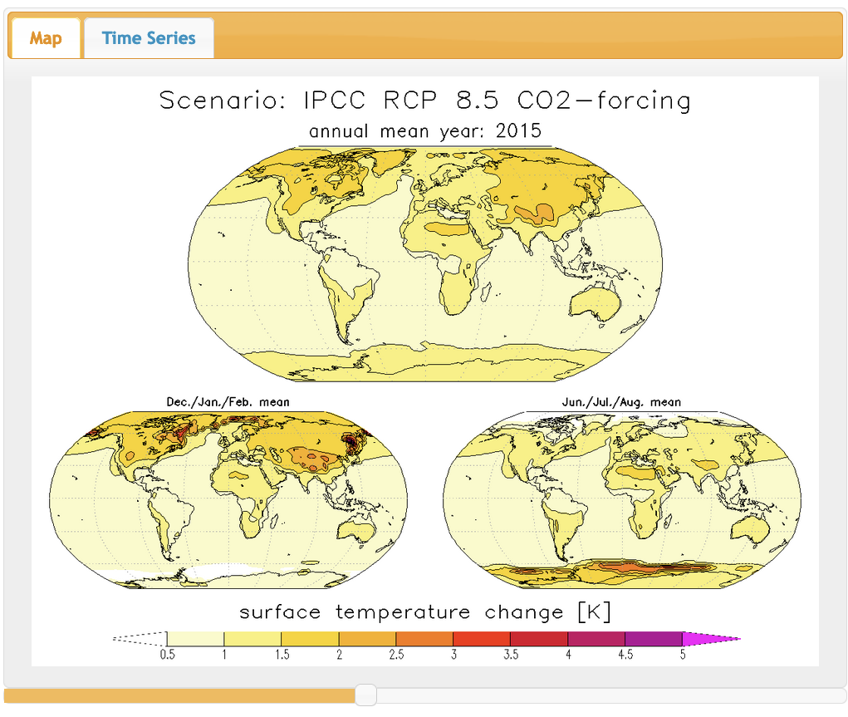
Weeks 5 and 3: Talked about regions most vulnerable to climate change

Slide 9
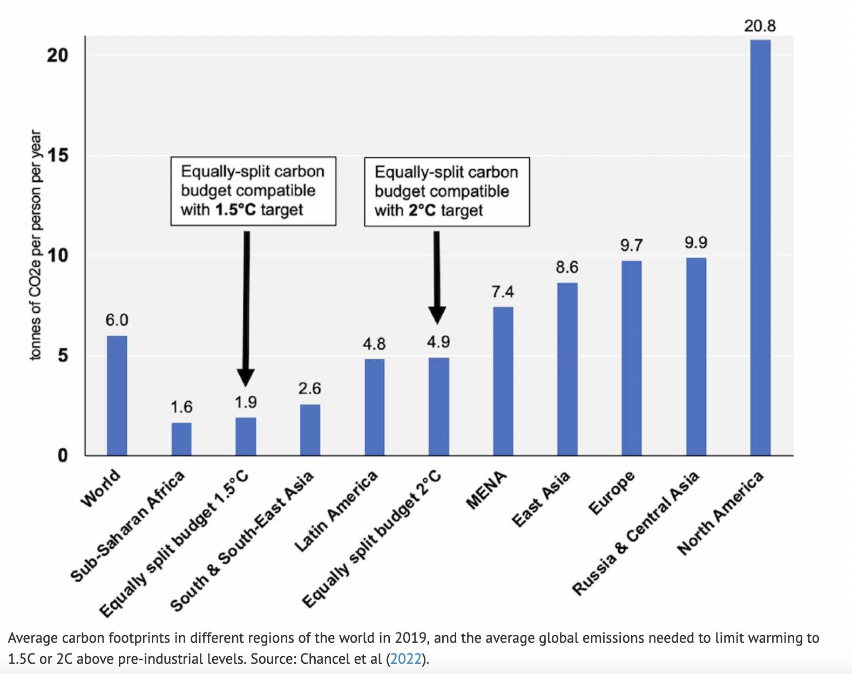

Week 5: Also talked about equally-split carbon budgets compatible with climate targets

Slide 10
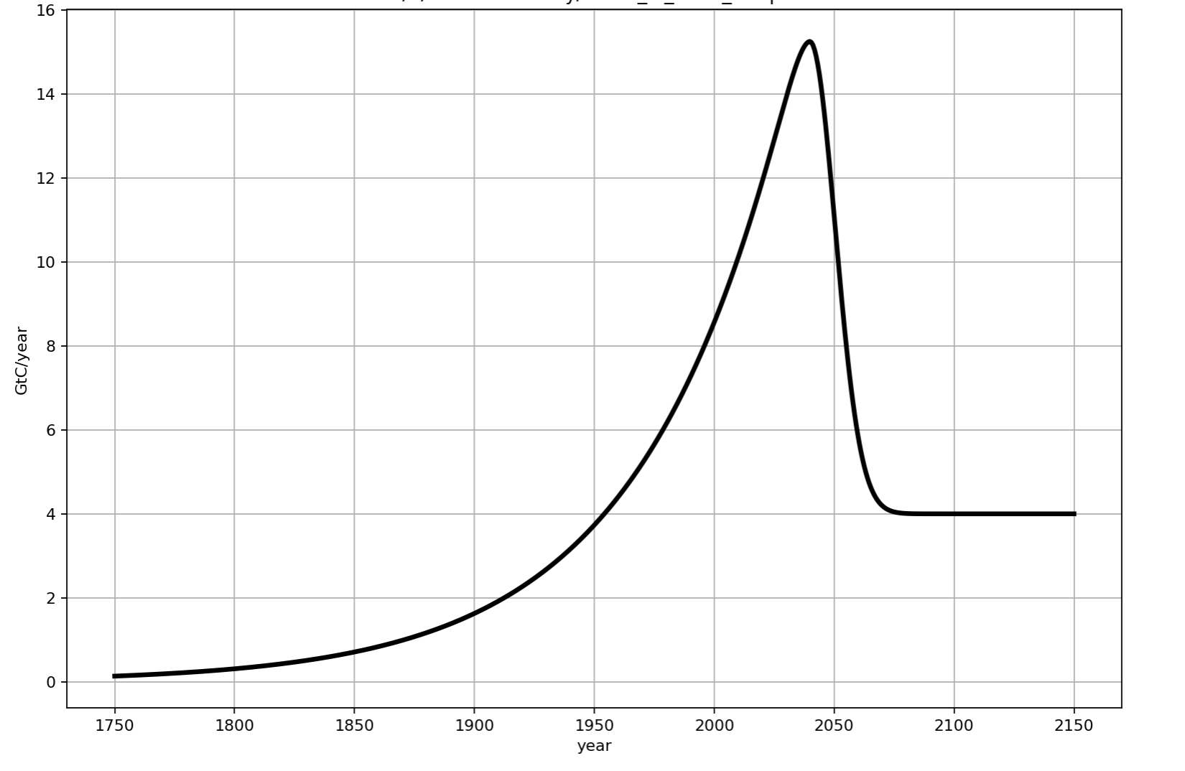
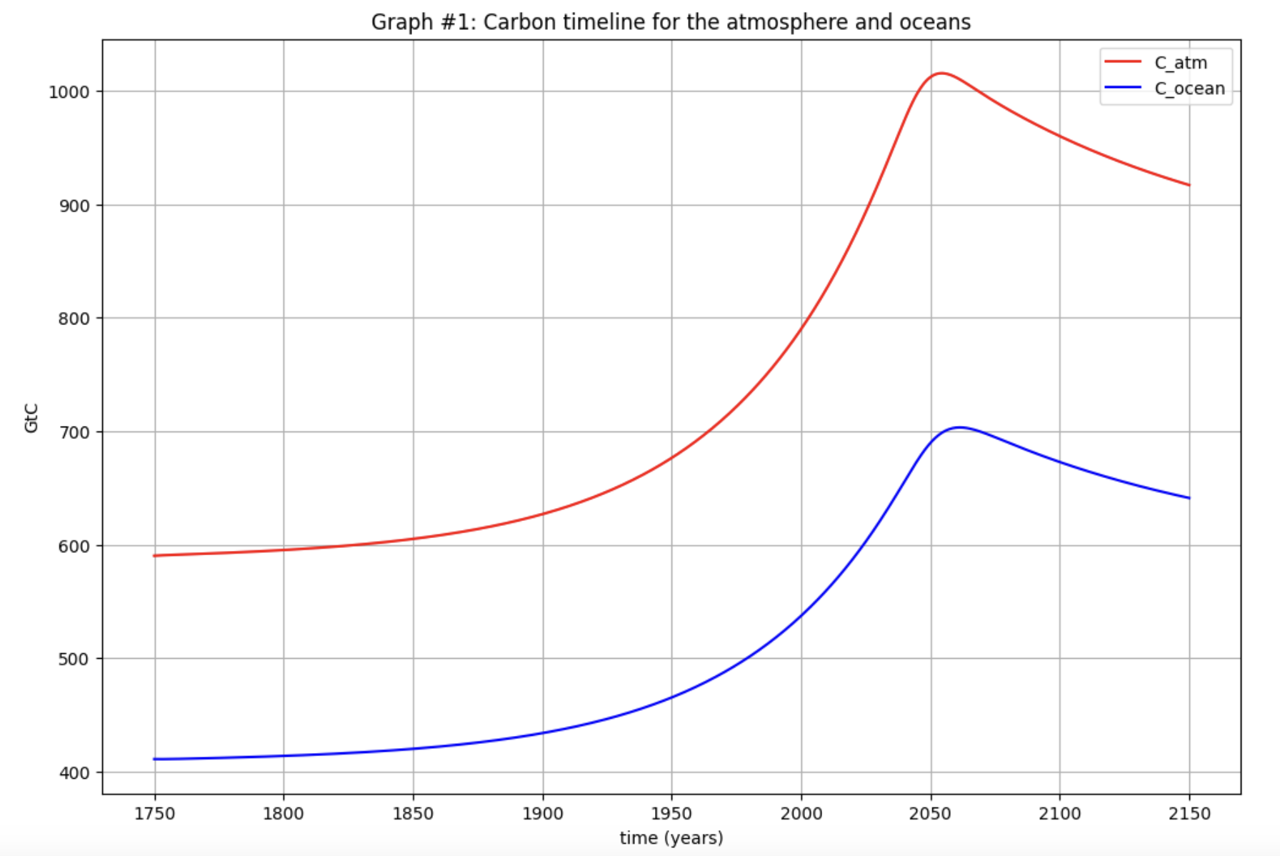
Week 6: Cambio 1.0 timelines of carbon in the atmosphere (Graph #1)
In this scenario, anthropogenic emissions peaked in the year 2040
But carbon in the atmosphere and ocean peaked in 2055!

Slide 11
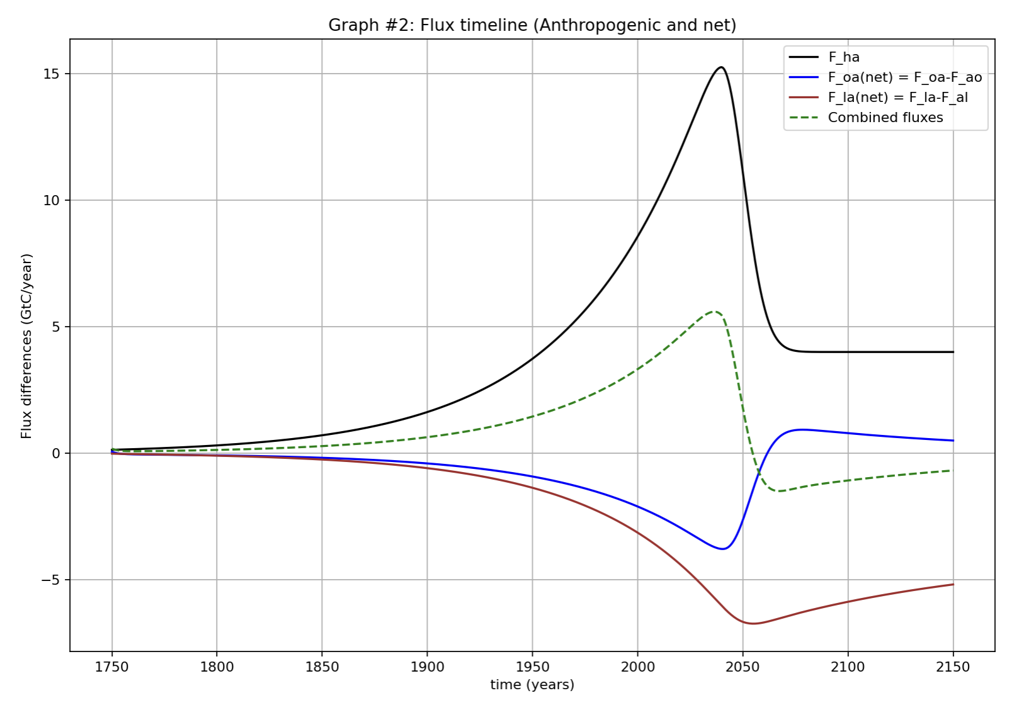
Week 6: Cambio 1.0 yimelines of carbon flux between atmosphere, ocean, and land (Graph #1)

Slide 12
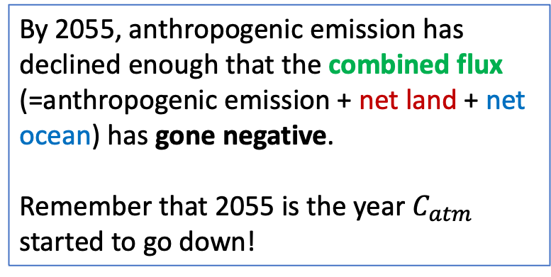
Week 6: Cambio 1.0 (Graph #2, flux timelines)
By 2055, anthropogenic emission has declined enough that the combined flux (=anthropogenic emission + net land + net ocean) has gone negative.
Remember that 2055 is the year $C_{atm}$ started to go down!

Slide 13
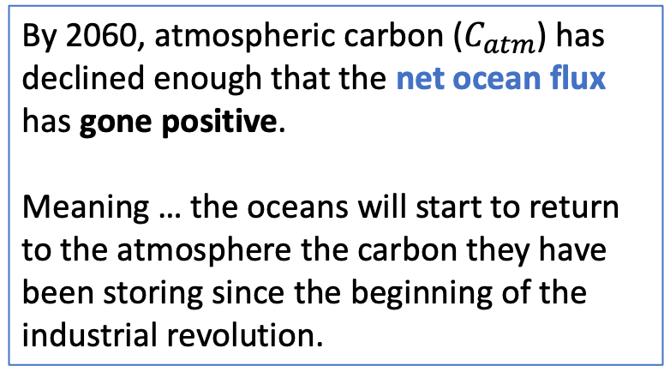
Week 6: Cambio 1.0 (Graph #2, flux timelines)
By 2060, atmospheric carbon ($C_{atm}$) has declined enough that the net ocean flux has gone positive.
Meaning … the oceans will start to return to the atmosphere the carbon they have been storing since the beginning of the industrial revolution.

